Slide 1
Internet of Dogs
A web 2.0 Application with JSF

Slide 2
Introduction
Our web application can be described as a social media event based site for dog owners where they can create event that will take place in real life. The activities are supposed to include their dogs. Other members of the site can then choose to join events.

Slide 3
Technologies
CSS
HTML
JavaScript
JSF
Cloudant - noSQL
DB2 – SQL

Slide 4
Functional Requirements

Slide 5
FR1.1
Title: Register account
Description: A user should be able to visit the website and register an account if they do not already have one. The user must provide their name, email address and password. Only one account for a given email address is allowed.
FR1.2
Title: Sign in
Description: Given that a user has registered an account, then the user should be able to login into the web application and access their feed.
Dependency: 1.1

Slide 6
FR1.3
Title: Forgot password
Description: Given that a user has registered an account, the the user should be able to request a new password if it is forgotten.
Dependency: 1.1
FR1.4
Title: Profile page
Description: A registered user should have their own profile page which they should be able to edit. This included their name, a profile picture, location, gender, description and dogs.
Dependency: 1.1, 1.2

Slide 7
FR1.5
Title: Dogs
Description: A registered and signed in user should be able to add their dogs on their profile page. When registering a dog, information must be entered. This included name, breed, age, gender and a picture.
A user should also be able to edit information about an already added dog as well as removing it completely.
Dependency: 1.1, 1.2, 1.4
FR1.6
Title: Create event
Description: A registered and signed in user should be able create a new event, when creating an event information must be supplied, this includes title, description, date, time and location.
Dependency: 1.1, 1.2

Slide 8
FR1.7
Title: View feed
Description: A registered and signed in user should see nearby event in his/her feed. The events in the feed should be filtered on the event location and the location set by the user in his/her profile.
Dependency: 1.1, 1.2, 1.4, 1.6
FR1.8
Title: Edit event
Description: A registered and signed in user should be able to edit his/her own events. Title, description, time and location should all be possible to edit.
Dependency: 1.1, 1.2, 1.6

Slide 9
FR1.9
Title: Cancel event
Description: A registered and signed in user should be able to cancel his/her own events.
Dependency: 1.1, 1.2, 1.6
FR1.10
Title: Request join event
Description: A registered and signed in user should be able to request to join other users events. The user should not get access to the event until the request has been approved.
Dependency: 1.1, 1.2, 1.6

Slide 10
FR1.11 Title: Approve join request
Description: A registered and signed in user should be able to approve or decline request from other users to join his/her event.
Dependency: 1.1, 1.2, 1.6, 1.10
FR1.12
Title: Comment on event
Description: A registered and signed in user that has joined an event should be able to post comments on that event.
Dependency: 1.1, 1.2, 1.6, 1.10, 1.11

Slide 11
FR1.13
Title: Leave event
Description: A registered and signed in that has joined another users event should be able to leave the event if desired.
Dependency: 1.1, 1.2, 1.6, 1.10

Slide 12
FR1.14
Title: Notifications
Description: A registered and signed in users should see notifications if things have happened. The following event should trigger a notification.
A user has requested to join your event.
Join event request has been approved or declined.
Joined event has been updated.
Joined event has been cancelled.
Comment posted on joined or own event.
Notifications should be marked as read once they have been viewed.
Dependency: 1.1, 1.2

Slide 13
System Requirement
User interaction
Web server
Bluemix
Websphere
Database
DB2 – SQL
Cloudant - NoSQL

Slide 14
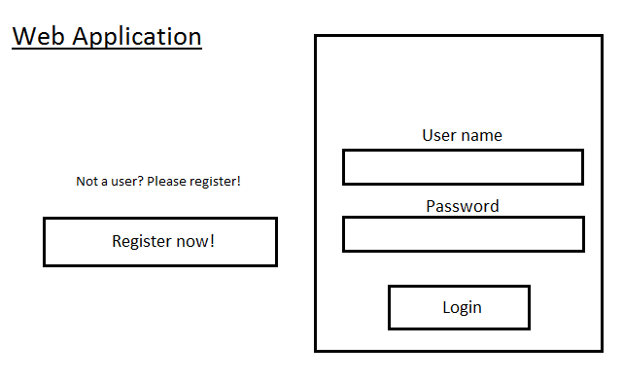
User interface

Slide 15
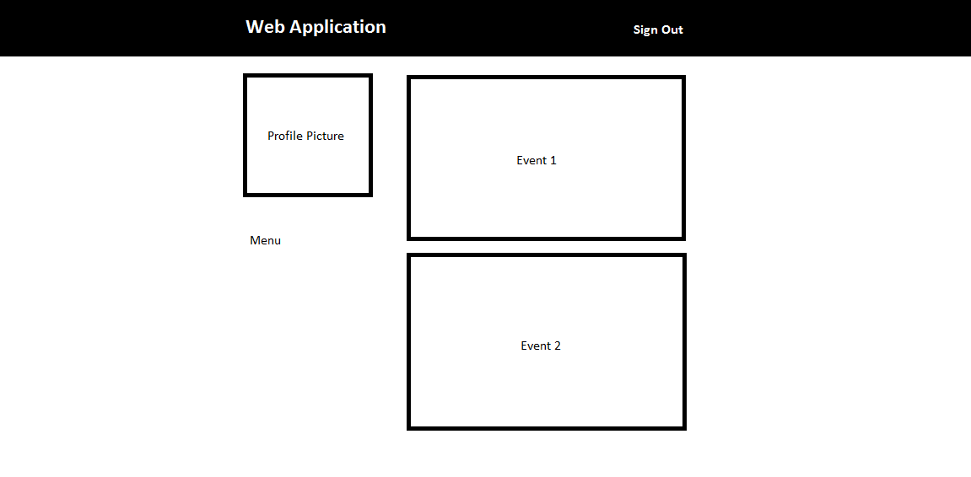
User interface

Slide 16
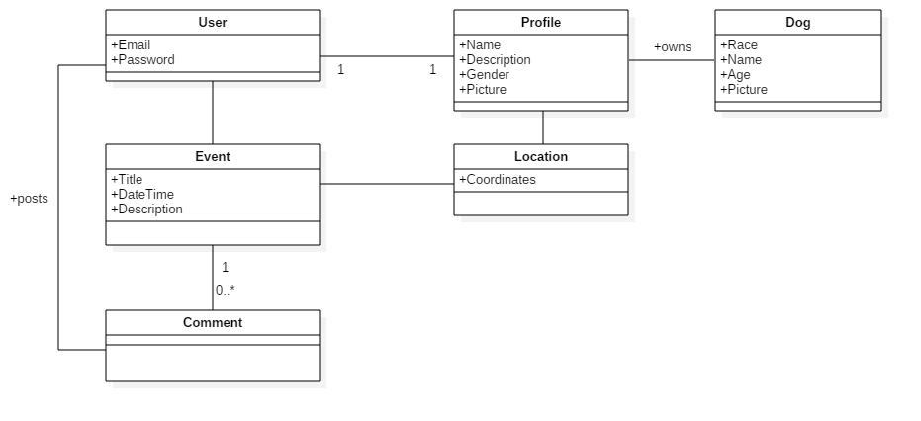
Domain Model

